Slide 1
INFORMATION ENCODING STANDARDS
FINAL PROJECT

Slide 2
PROJECT SUMMARY
The main aim of our project is to create an ASP.NET Core web app with user data protected by authorization.
The first part was about creating a web app that shows how contacts can be managed between 3 different classes of users – Registered users, Managers and Administrators.
Registered users can view all the approved data and can edit/delete their own data.
Managers can approve or reject contact data. Only approved contacts are visible to users.
Administrators can approve/reject and edit/delete any data.
The second part of our project is answering questions related to Security Technologies recommendations as upcoming engineers.

Slide 3
GROUP MEMBERS
Abdul-Baatinul-Haad Yusuf - 200497977
Aiswarya Prakash - 200500058
Alla Krishna Chaitanya Reddy - 200511205

Slide 4
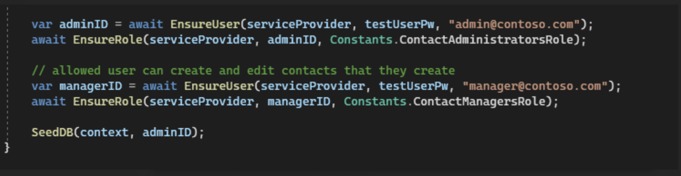
PART 1 - DEMONSTRATION
Created admin and manager accounts.

Slide 5
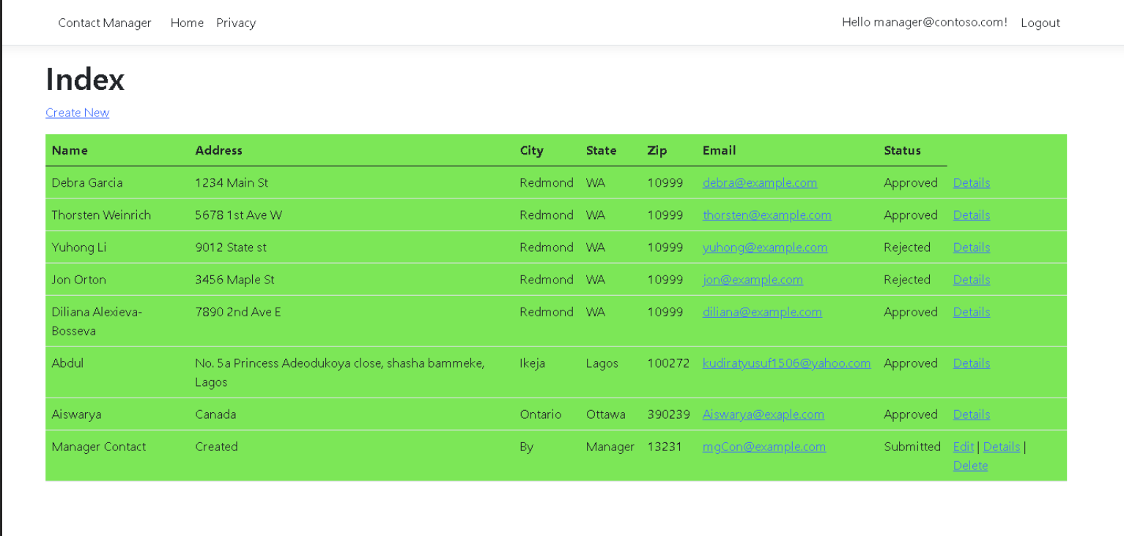
Manager account page

Slide 6
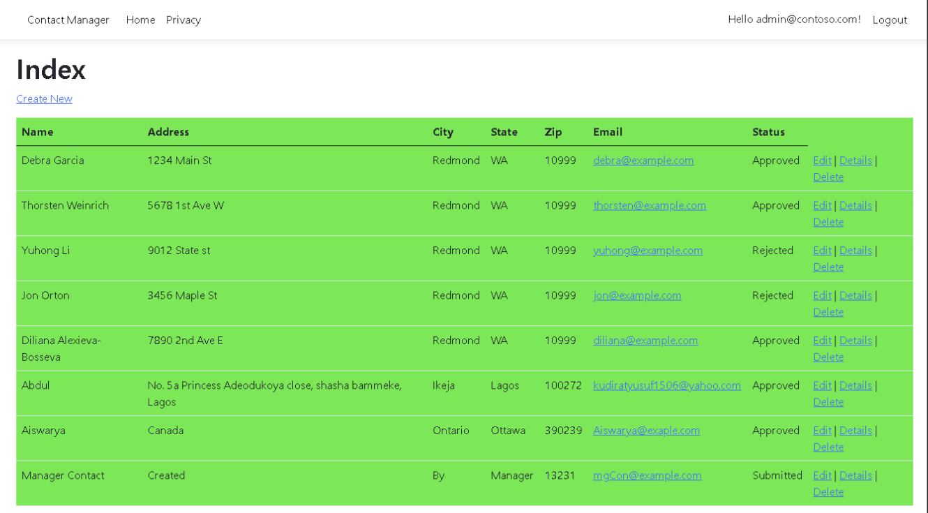
Admin account page

Slide 7
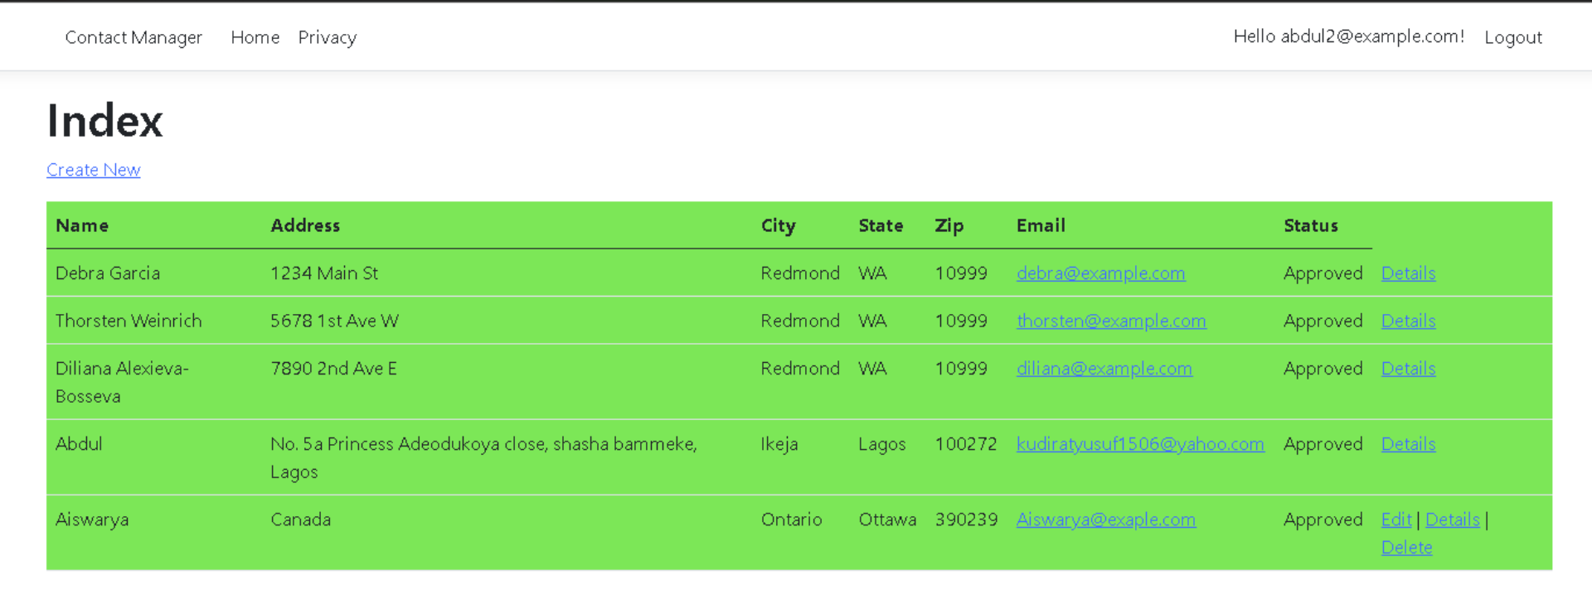
User account page

Slide 8
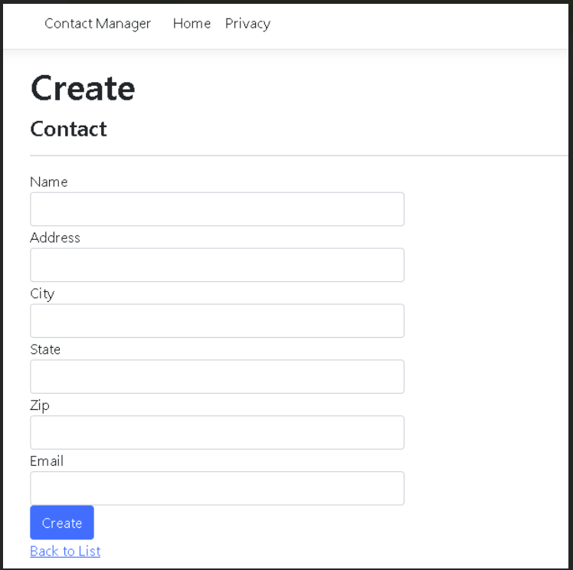
Create new contact page

Slide 9
PART 2
How can we transfer personal data securely within their network?
Encrypting the data is one of the simplest ways to protect the transfer. To protect data from cyber attacks, a variety of encryption devices are available. The best option is to pick a solution that offers not just encryption, but also authenticated key agreements, and passwords and encrypted with Bcrypt. Installing a data transfer converter is also a smart option. This allows to view how much data has been successfully sent.
Another way to protect data transfer is using FTP (File Transfer Protocol). FTP will allow us to transfer data only if we type in the correct username and password, ensuring we are the one who did that.

Slide 10
What security protocol is best for transferring personal files?
HTTPS is a secure file transfer protocol that is used to send sensitive data from a user to a website. Any transfers requiring a password should only be sent using the HTTPS protocol. It secures data integrity and privacy by encrypting a website's inbound traffic and introducing an encryption layer via TLS. It protects a web visitor’s identity and secures account details, payments, and other transactions involving sensitive details. When it comes to file transfers, this protocol allows users to upload data from business partners or consumers using a simple but secure interface.

Slide 11
Can we encode and encrypt images?
Software can encrypt a picture in the same way it can encrypt words. Encryption software modifies the values of the numbers in a predictable way by performing a series of mathematical operations on the binary data that makes up an image. We need a software key to decrypt the encryption code, which is generated by the same software that scrambles the image. The encrypted image and the key are provided to the receiver separately to reduce the chances of both being intercepted by a hacker

Slide 12
Our database cannot be moved from the site and we need to be able to access it externally using a secure API. Can you explain the architecture of a secure API?
The architecture of a secure API is the technical framework of a developing software interface that exposes application functionality and backend data for use in external applications. It entails components for traffic control, data access, external interfacing, and runtime execution of business logic. API Gateways are also a necessary component of a secure API architecture, since it works as a server focused on traffic control. It also detects attacks that may expose your APIs to risks.

Slide 13
Can you recommend a secure framework for coding an API?
There are many good and popular frameworks that could be used in the coding of an API, however, after extensive research, my group has come to an agreement that the most secure is ASP .NET Core. This is because, security feature like Authorization and Authentication are built into the framework. The built-in authorization libraries provide the ability to deny access based on attributes and roles defined for users. It also has a Data Protection API which gives developers a perfect abstraction to encrypt data at rest. The only downside to this very secure framework is that JSON parsing libraries, written by third parties are many at times vulnerable to insecure JSON deserialization attacks.

Slide 14
What data interchange format should we use while transferring data between locations?
JSON is the de facto standard for exchanging data between web servers and browsers. Its simple design and flexibility make it easy to read and understand and easy to manipulate in the programming language of our choice. The lack of a strict schema enables flexibility of the format, but that flexibility sometimes makes it difficult to ensure that we are reading and writing JSON properly.

Slide 15
How should we store our data in our many locations?
Cloud Storage
This digital storage option is very popular due to its various advantages. Cloud storage has removed the need to keep files on computers by offering an organized way to find, share, and control information. Data is not actively mined like social media storage nor is it lost or damaged. There is immediate synching and access from any device for greater convenience. Some even features revision history so we can return to an older version of a digital file.
Cold Storage
Cold Storage is one of the cost-effective ways to store large files in a relatively secure way. This includes separate drives, such as flash and thumb drives, and SD cards. Once plugged into a desktop or laptop device, the files can be categorized so that information can be readily found and shared. But the main disadvantage of this type is data can be easily lost or damaged. Also, external drives often need maintenance after a few years and if corrupted, they need to migrate all that information to a new device.

Slide 16
What are the ethical concerns related to the transmission of personal data?
Unauthorized access to personal data
Use of personal data inappropriately
Unauthorized transmission of personal data
Violation of privacy, intellectual property, and other interests.
Aside from the above mentioned, there are a lot more ethical issues that may arise when transmitting personal data. To prevent this, use of secure file transmission systems like Secure File Transfer Protocol (SFTP) helps to secure your data. With SFTP, your data is encrypted using a secure shell, and both the receiver of the data, and the server that transmits the data are authenticated, to make sure that the data is sent securely. SFTP is a connection-oriented protocol, and thus uses (Transmission Control Protocol) TCP, which guarantees file transfer.

Slide 17
THANK YOU

